Slide 1


Mapping of third sector organisations in Kirklees which work with people with mental health issues, physical disabilities, learning disabilities and autism

Slide 2
Standard Survey – added physical disabilities
Promoted through TSL, networks: youth housing, mental health, domestic abuse
63 replied
32 phone interviews
Ranged from outdoor activities for disabled to OT, Yoga, autism provision, stroke victims
Notes:
A number of groups stated their services were open to all people but they did but not specifically targeting people with disabilities, mental health issues or autism. Services were extensive and listed below; they ranged from cultural, sports activities to day services, women only services, support for women who experienced abuse, people seeking asylum to services for people who had sight impairment, people with mental health issues related to drug and alcohol issues. There were a small minority of groups supporting people with autism.

Slide 3
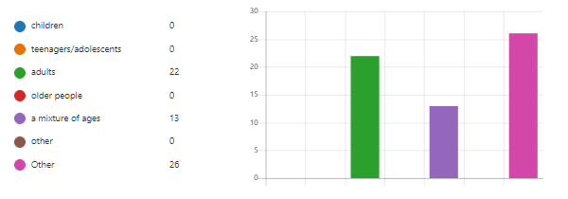
Users
Over half groups supported wide age range, children to adults
Needs of users – 1 specifically targeted autism, others mixed
Supported from 8 to 3000 users, latter on line huge increase
Half groups served all Kirklees, few groups smaller neighbourhoods eg Lindley, Almonbury

Slide 4
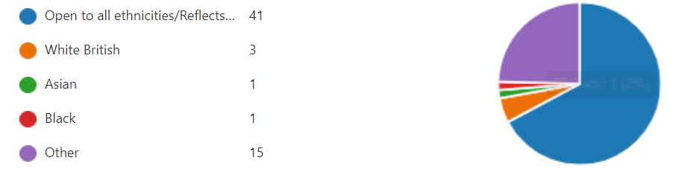
Income Large majority felt they were financially viable Over half groups lost income during 20/21 Ethnicity

Slide 5
Help to sustain organisation 33% of respondents answered ‘Funding’ to this question. However many wanted support to: Develop business plan and promote core business Link with other groups, connecting with other services Building good relationships with other VCS groups and commissioners Help recruiting and supporting volunteers Link more with social prescribing agenda One suggested an event to showcase their work, any contacts with other occupational therapists, health services Access to free training outside normal working hours Recognising value of VCS Parity of esteem between public sector and VCS Organisations and funders to have meaningful strategies for voluntary sector inclusion Organisations and funding bodies have community and volunteer champions

Slide 6
Digital technology Only 3 groups did not use IT, no phone, no skills, worked outside and not needed
How should SWYFT engage with VCS in Kirklees?
Networking events with loose agenda to allow free dialogue
Visits to groups
Perhaps they could organise regular groups which meet to discuss mental health issues, with other providers and commissioners
Like Kirklees, send application forms to groups for SWYFT grants
New community directory
Facebook
Email updates – nearly every group suggested this

