Slide 1


Kirklees Community Safety Partnership
Lee Hamilton – Safer Kirklees
Chris Walsh – Performance Manager

Slide 2
Overview
Background – current Kirklees Communities Partnership Plan
Kirklees Strategic Intelligence Assessment
Involving the Community & Voluntary Sector in delivering priorities
Links for feedback and further information

Slide 3

The Communities Partnership Plan 18-21
Strategic Priorities
Tackling
Anti-Social Behaviour
Reducing Crime
Protecting People from Serious harm
Improving Place

Slide 4
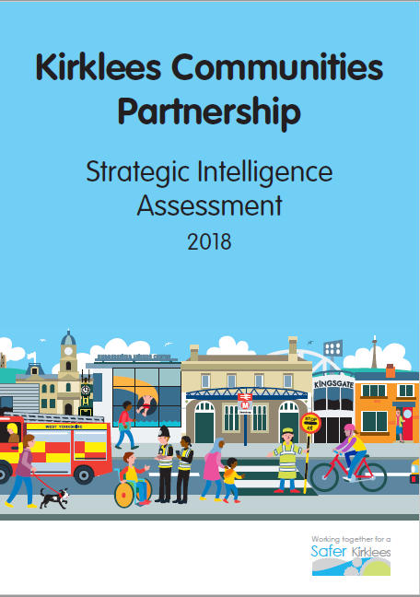
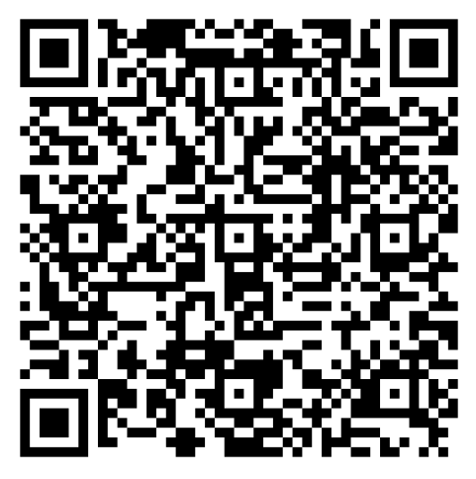
Strategic Intelligence Assessment
What is the Strategic Intelligence Assessment?
What areas does it focus on?
Opportunity to contribute / input
https://online1.snapsurveys.com/3sdqas

Slide 5
Areas in the Survey
Rating (from 1 to 10) of how involved your organisation has been in the delivery of the current Strategy.
Identify priorities from your organisation’s perspective to make Kirklees safer.
Reflecting on and highlighting key challenges for your organisation which might be addressed in partnership.
Best ways to get involved in future work to create a safer Kirklees.

